Slide 1

PROJECT 5
Matias Becker Burgos & Sam Hurenkamp
Finding biomarkers associated with Influenza A Virus (IAV) in human and avian hosts by classification on the Polymerase PB2 proteins.

Slide 2
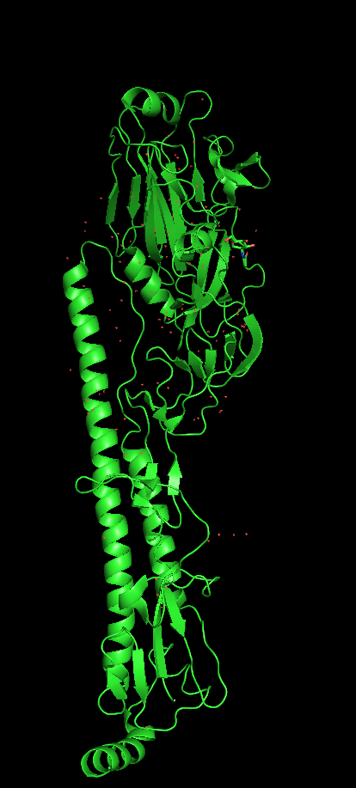
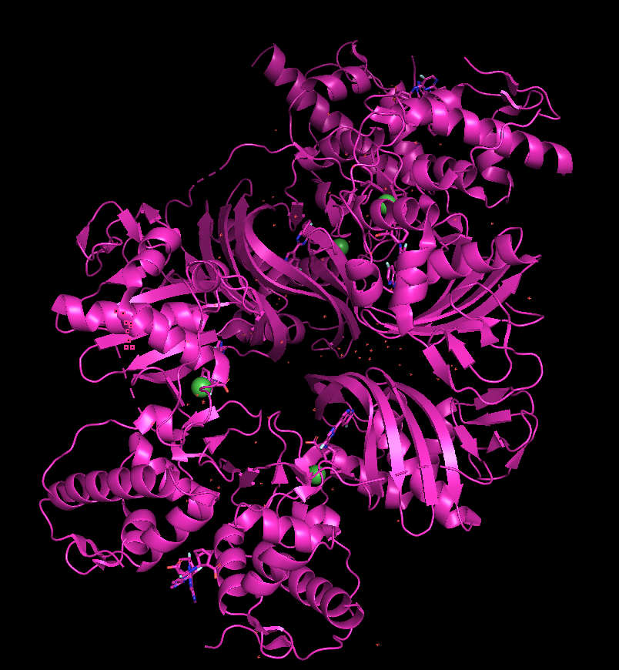
(Brief) background
Hemaglutinin
Well known crucial component in adaptation to new hosts
But other protein subunits play a role in the adaptation of IAVs to different Host.
PB2
PB2 is one of three subunit of the IAV polymerase; PB2, PB1, PA. ^{[1]}
Major virulence determinant responsible for association with host mtDNA ^{[1]}
Notes:
Hemaglutinin:
Usually studied to found the Host Relationship
PB2:

Slide 3
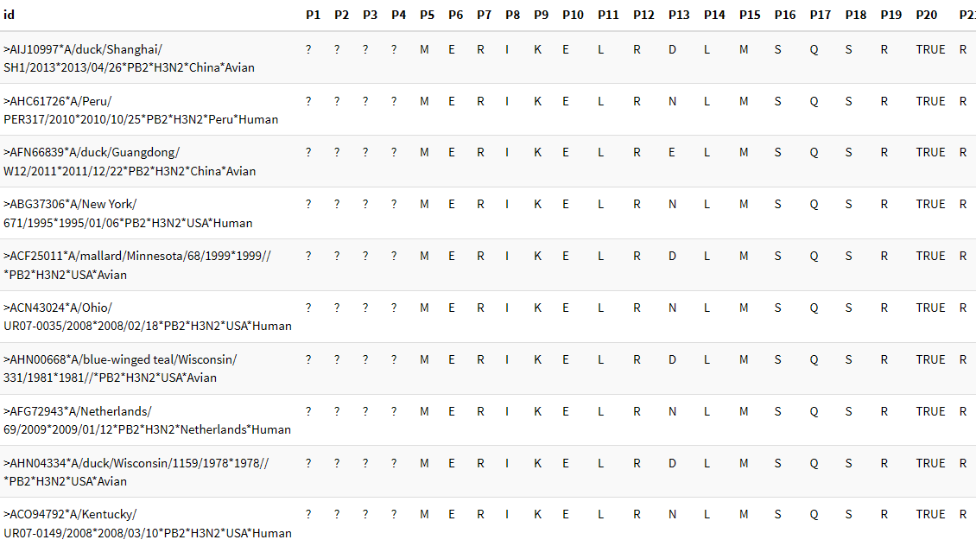
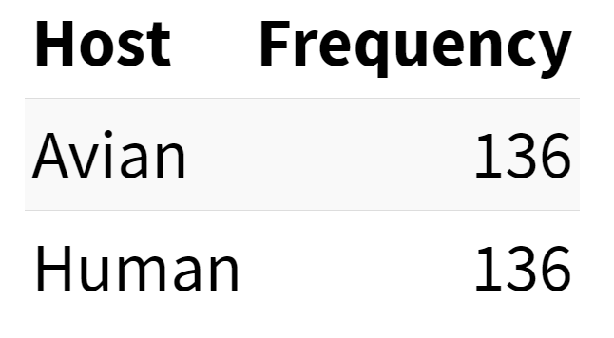
Data Exploration & Preprocessing
Considerations
shape = (272, 778)
Each column represented a position and the rows were the respective AA found in the sample at this position
This was only a small subset of the original data.
Class balance
We were only given the H3N2 strain to work with
Removed gap-only columns, and columns which were >80% gaps
Corrected TRUE → T (Thr) and FALSE → F (Phe).
Shape after correction: (272, 761)
– 17 columns (attributes) removed.

Slide 4
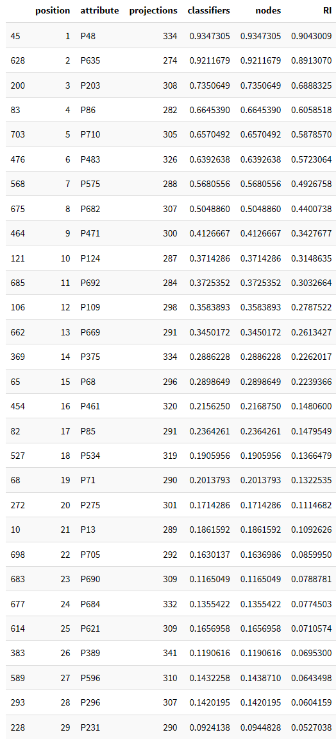
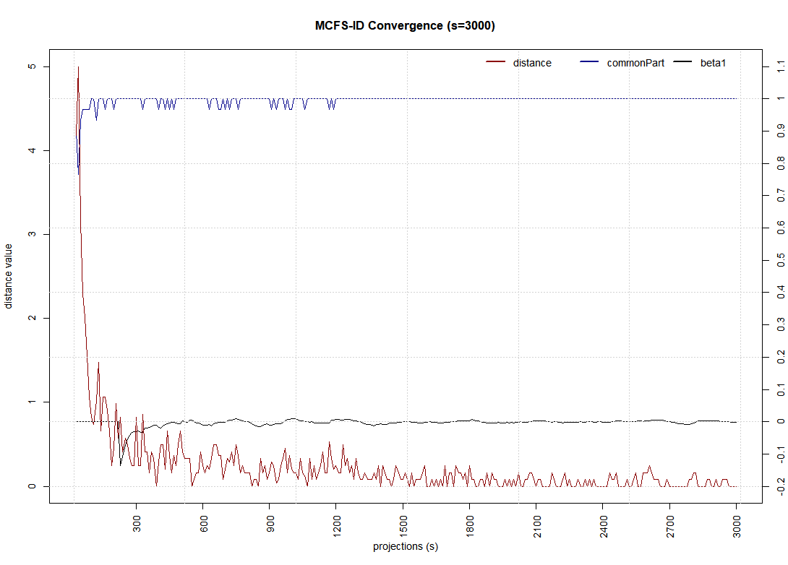
Feature Selection
MCFS
Top 29 attributes
3000 projections (subsets) | Splits = 5 (per subset)
Projection size: 0.1 = 10% (76) attributes
cutOffPermutations = 20 (minimum for statistically sig. result)
Distance plot shows that feature rankings fully stabilized after ~1500 projections

Slide 5
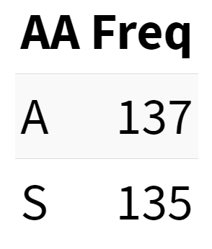
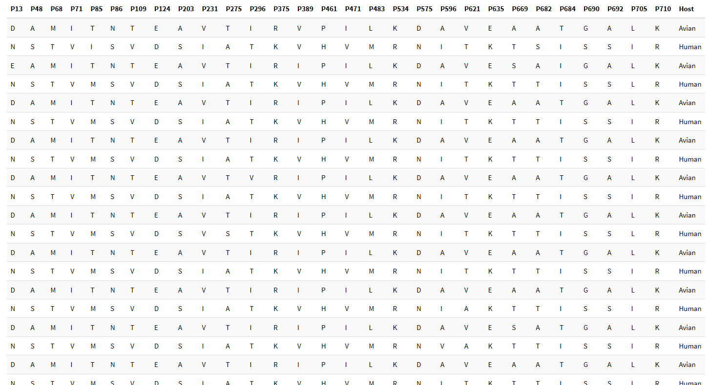
Feature Selection
Top 29 attributes
IF (P48=A) THEN Host=Avian
IF (P48=S) THEN Host=Human
(272, 30)
(~ -96% attr.)

Slide 6
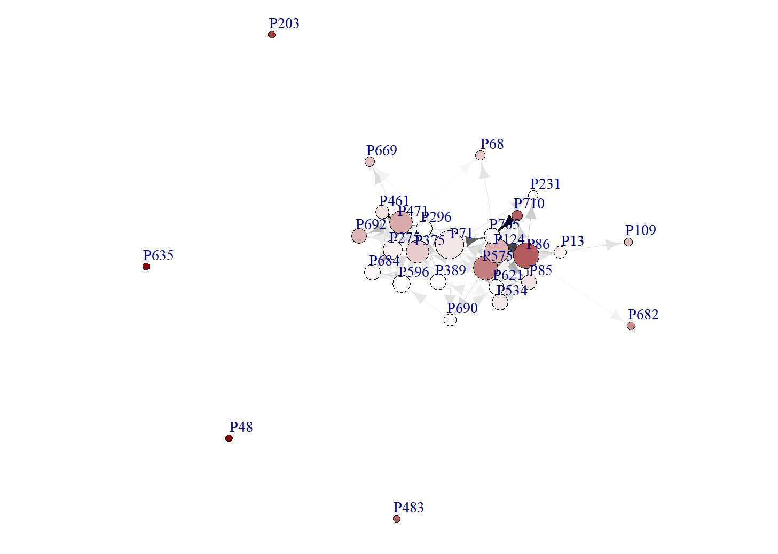
Feature Selection
Top 29 attributes
(272, 30)
(~ -96% attr.)

Slide 7
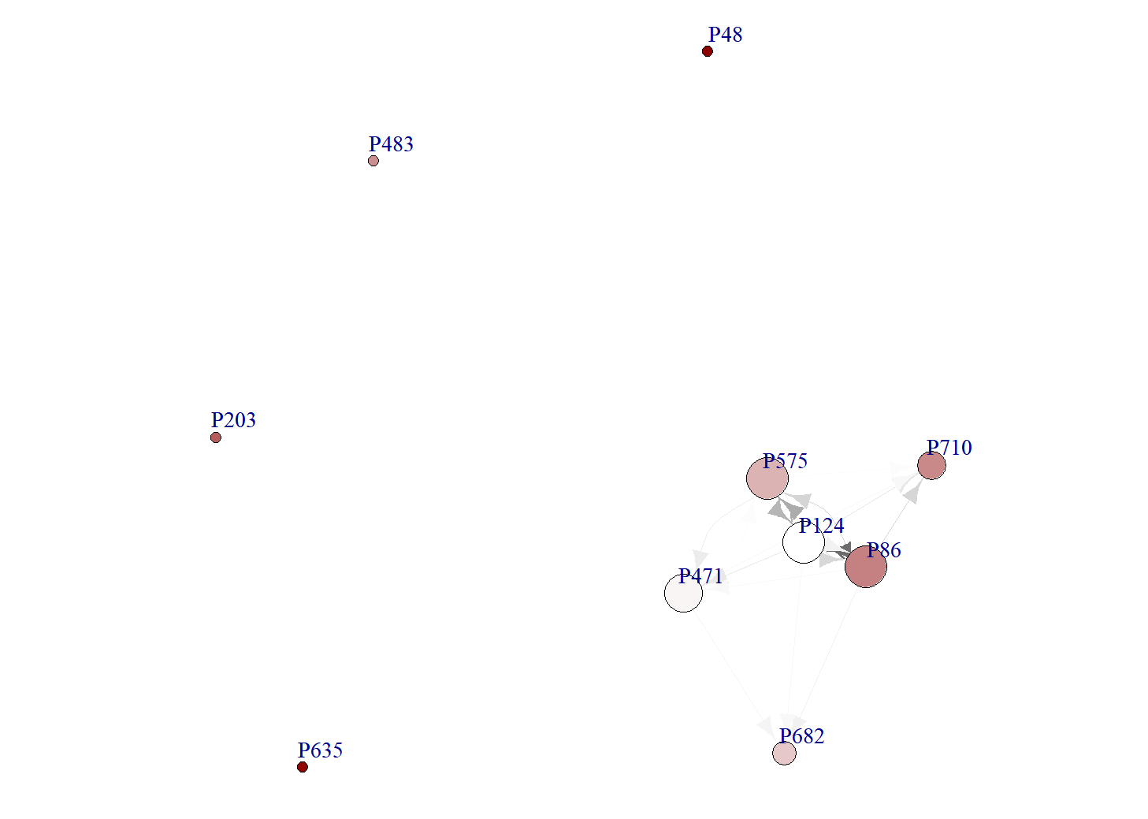
Feature Selection
Top 29 attributes
(272, 30)
(~ -96% attr.)

Slide 8
Feature Selection - mcfs::idgraph
Top 29 attributes
* No interdependence on these nodes
(272, 30)
(~ -96% attr.)

Slide 9
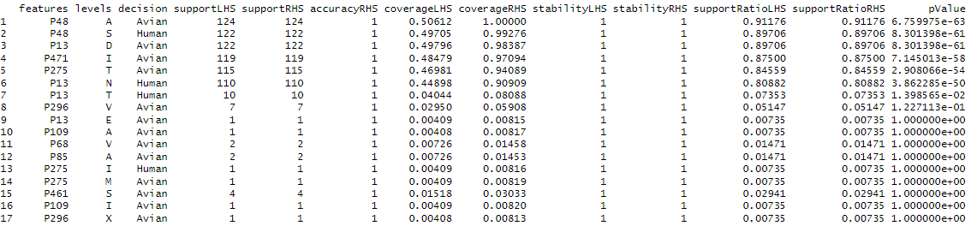
Classification and Visualization
Johnson Reducer
Greedy algorithm – maybe too simplistic despite perfect accuracy, statistical support and near-perfect coverage?

Slide 10
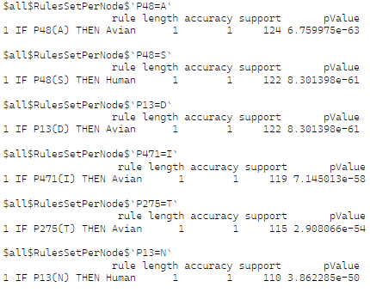
Classification and Visualization
Johnson Reducer
rosetta(result$data, discrete=T, roc = TRUE, clroc = "Human")
Greedy algorithm - too restrictive & simplistic despite perfect accuracy, statistical support and near-perfect coverage?
min(Acc)=0.98
Min(Cov)=0.90

Slide 11
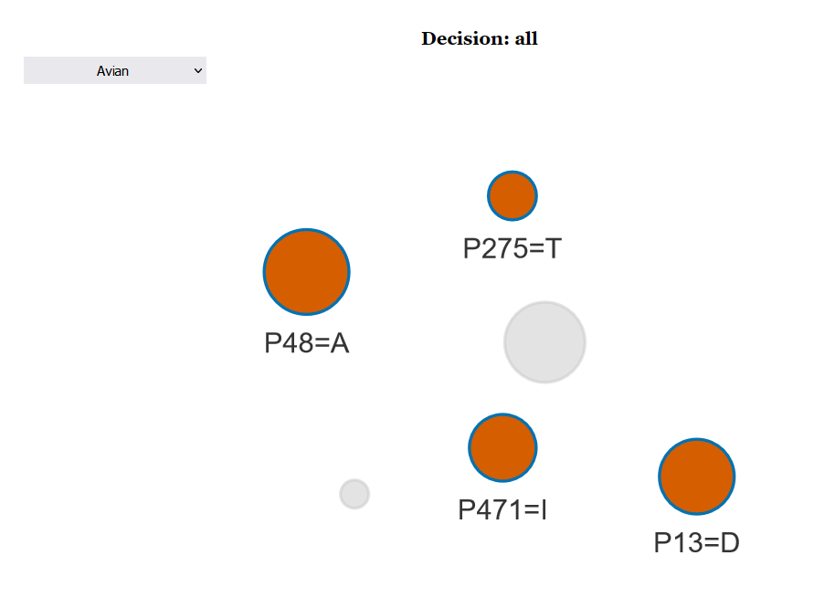
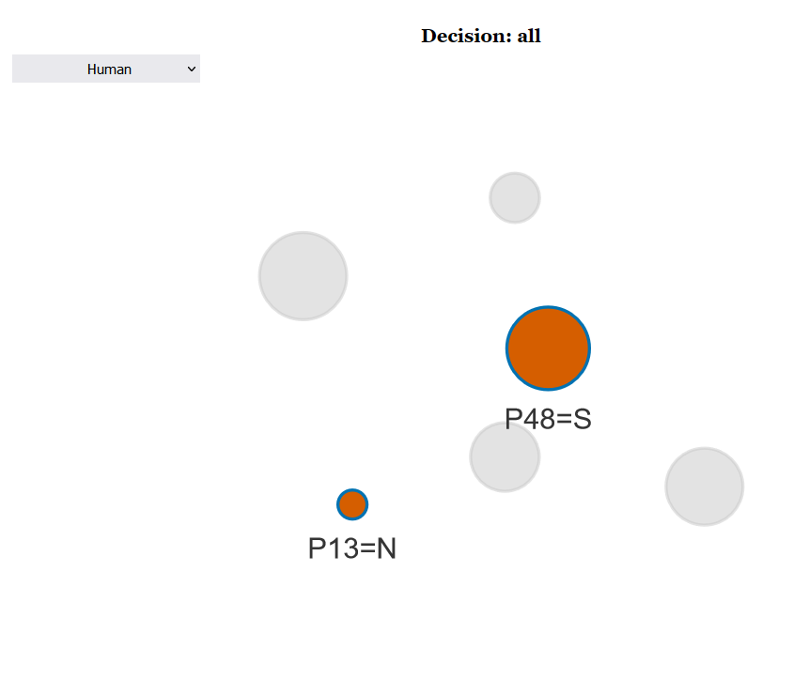
Classification and Visualization
Johnson Reducer
Top 15 nodes
min(Acc)=0.98
Min(Cov)=0.95

Slide 12
Classification and Visualization
Johnson Reducer
Top 15 nodes
min(Acc)=0.98
Min(Cov)=0.95
Greedy algorithm does not look for connections between nodes; too simplistic?

Slide 13
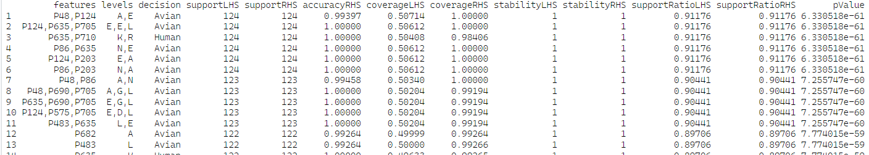
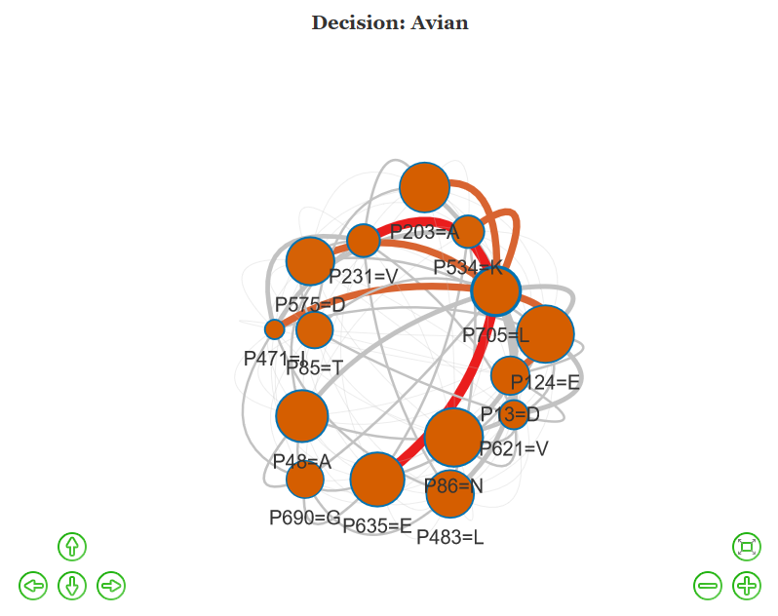
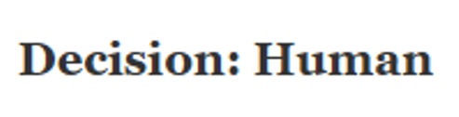
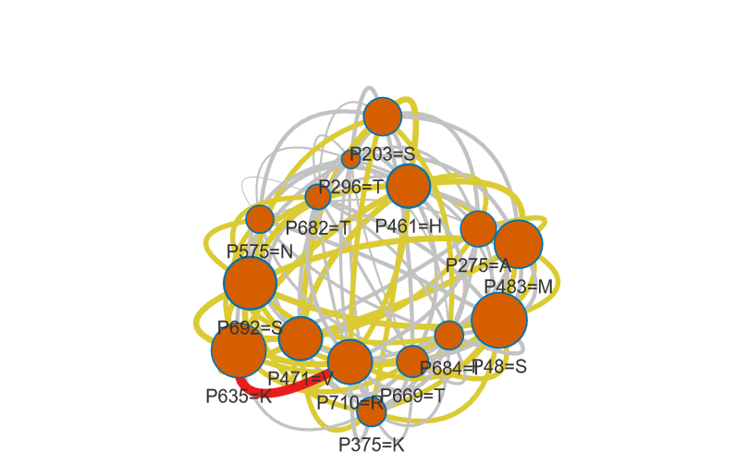
Classification and Visualization
Genetic Reducer
rosetta(result$data, discrete=T, roc = TRUE, reducer="Genetic", clroc = "Human")
Total significant results
Avian: 434 rules
Human: 390 rules
Top 15 nodes
min(Acc)=0.98
Min(Cov)=0.95
Total: 824 rules
* Only able to compute top 15 rules per decision class
Notes:
The genetic algorithm is based on Darwin’s theory of natural selection
function optimization that follows the “survival of the fittest” idea
Which can make sense in an evolutionary relationship from avian to human
Legend VisuNet:
Connetion value: yellow >55%
Orange >75%
Red > 85%
Node size:
Bigger more coverage/support
Avian lot of rules but less high coverage
Human less rules but more high coverage /highly interconnected

Slide 14
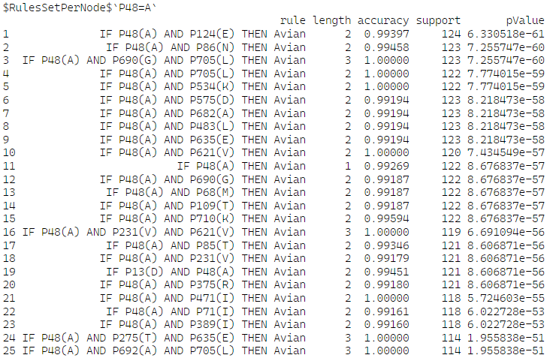
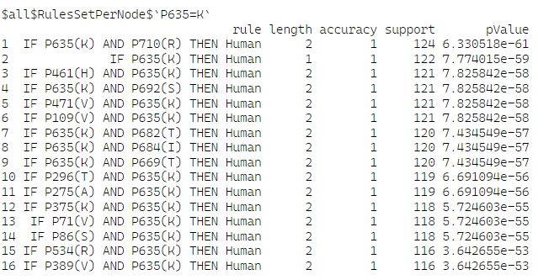
Classification and Visualization
Genetic Reducer
Notes:
Provided a way bigger amount of IF-THEN

Slide 15
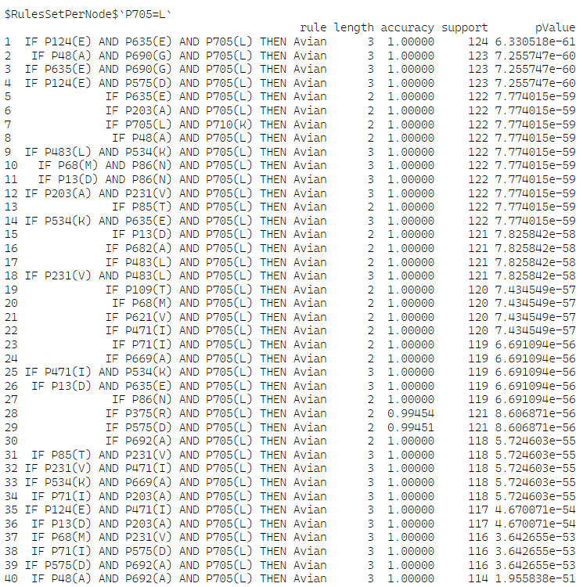
Classification and Visualization
Genetic Reducer

Slide 16
Conclusion & Biological Implications
Host | Position (AA) in result | Position (AA) in Paper | Shift
Avian | 13 (= D) | 9(= D) | +4
Avian | 275( = T) | 271(= T) | +4
Human | 13(= N) | 9(= N) | +4
Johnson
Host | Position (AA) in result | Position (AA) in Paper | Shift
Avian | 13( = D) | 9(=D) | +4
Avian | 85(= T) | 81( =T) | +4
Avian | 86( = N) | 82(= N) | +4
Avian | 621 (= V) | 613 (= V) | +8
Human | 48 (= S) | 44 (= S) | +4
Human | 275 ( =T) | 271 (= T) | +4
Human | 375 (= K) | 368 (= K) | +7
Human | 692 (= S) | 684 (= S) | +8
Every “?”filtered column in the original data added +1 to the shift
Genetic
Notes:
P300
P313
P350
P775-8
P772-6

Slide 17
Conclusion & Biological Implications
Host | Position (AA) in result | Position (AA) in Paper | Shift
Avian | 13 (= D) | 9(= D) | +4
Avian | 275( = T) | 271(= T) | +4
Human | 13(= N) | 9(= N) | +4
Johnson
^{[2]}
Host | Position (AA) in result | Position (AA) in Paper | Shift
Avian | 13( = D) | 9(=D) | +4
Avian | 85(= T) | 81( =T) | +4
Avian | 86( = N) | 82(= N) | +4
Avian | 621 (= V) | 613 (= V) | +8
Human | 48 (= S) | 44 (= S) | +4
Human | 275 ( =T) | 271 (= T) | +4
Human | 375 (= K) | 368 (= K) | +7
Human | 692 (= S) | 684 (= S) | +8
^{[2]}
Every “?” filtered out column in the original data added +1 to the shift
Genetic
Notes:
“?” column
P300
P313
P350
P775-8
P772-6

Slide 18
Conclusion & Biological Implications
Conclusion
The Johnson reducer was likely too simplistic for identifying reliable biomarkers that do justice to the biological complexity of host selection in the strain
The Genetic reducer found a strong list of rule sets per attribute, with high support and coverage in its decision as well as significant statistical support.
Biological Implication
The studies of such biomarkers can develop the possibility of tracing the virus and found possible inter-species transmission markers.
More research into the significance of the changes in the biochemical properties of the point mutations at the select sites is required to effectively combat the zoopathogen.

Slide 19
References
[1] Graef, K. M., Vreede, F. T., Lau, Y.-F., McCall, A. W., Carr, S. M., Subbarao, K., & Fodor, E. (2010). The PB2 Subunit of the Influenza Virus RNA Polymerase Affects Virulence by Interacting with the Mitochondrial Antiviral Signaling Protein and Inhibiting Expression of Beta Interferon. Journal of Virology, 84(17), 8433–8445.
https://doi.org/10.1128/jvi.00879-10
[2] Khaliq, Z., Leijon, M., Belák, S. et al. Identification of combinatorial host-specific signatures with a potential to affect host adaptation in influenza A H1N1 and H3N2 subtypes. BMC Genomics 17, 529 (2016).
https://doi.org/10.1186/s12864-016-2919-4

Slide 20
Thank you for listening!

Slide 21
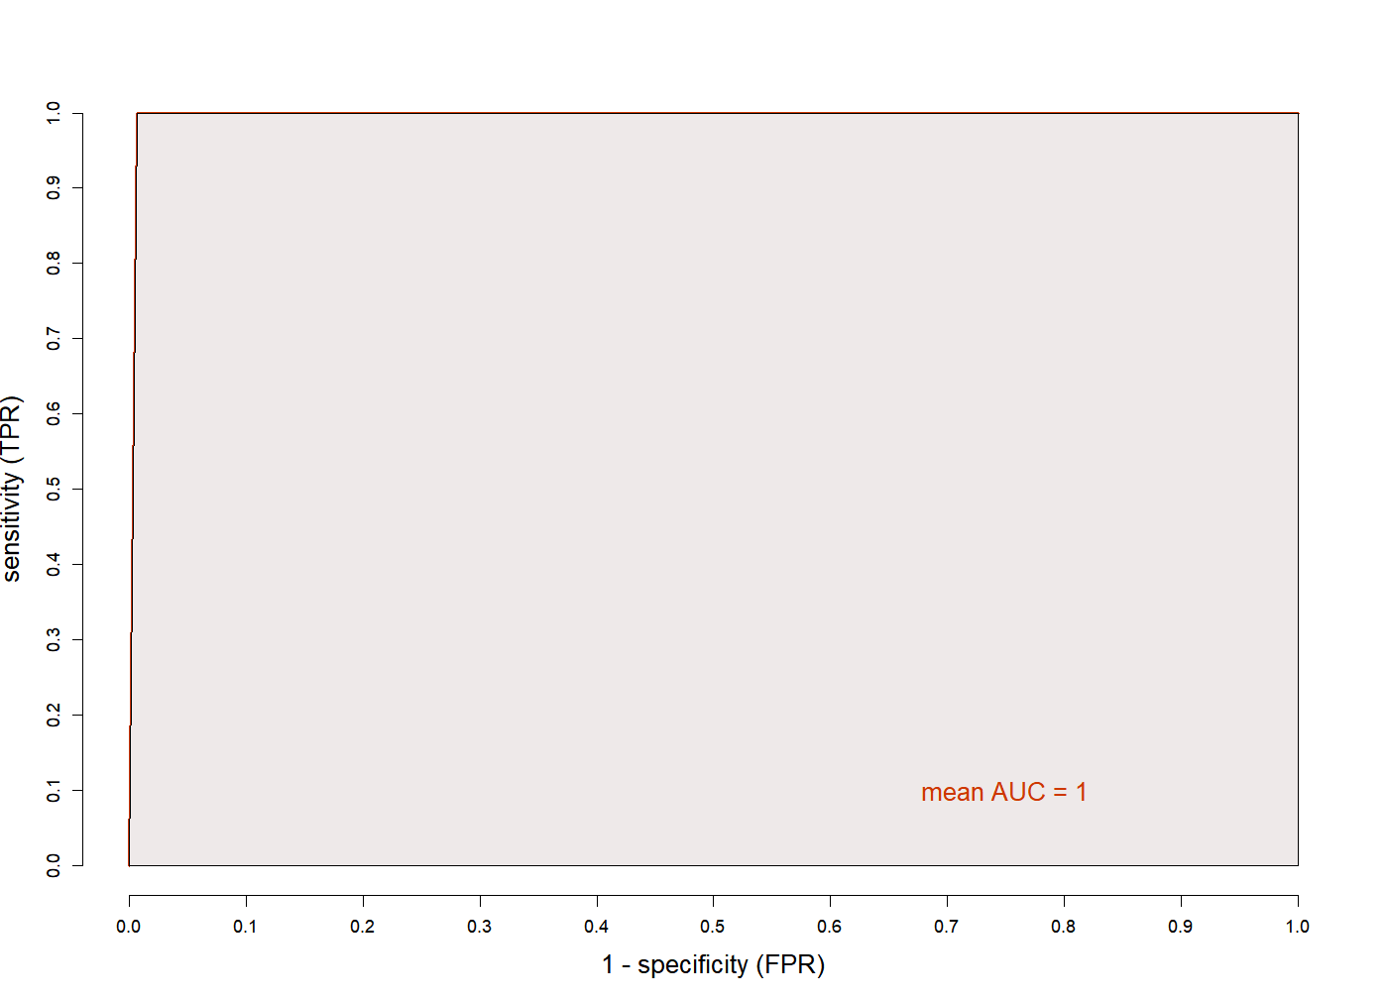
ROC
Johnson Reducer

Slide 22
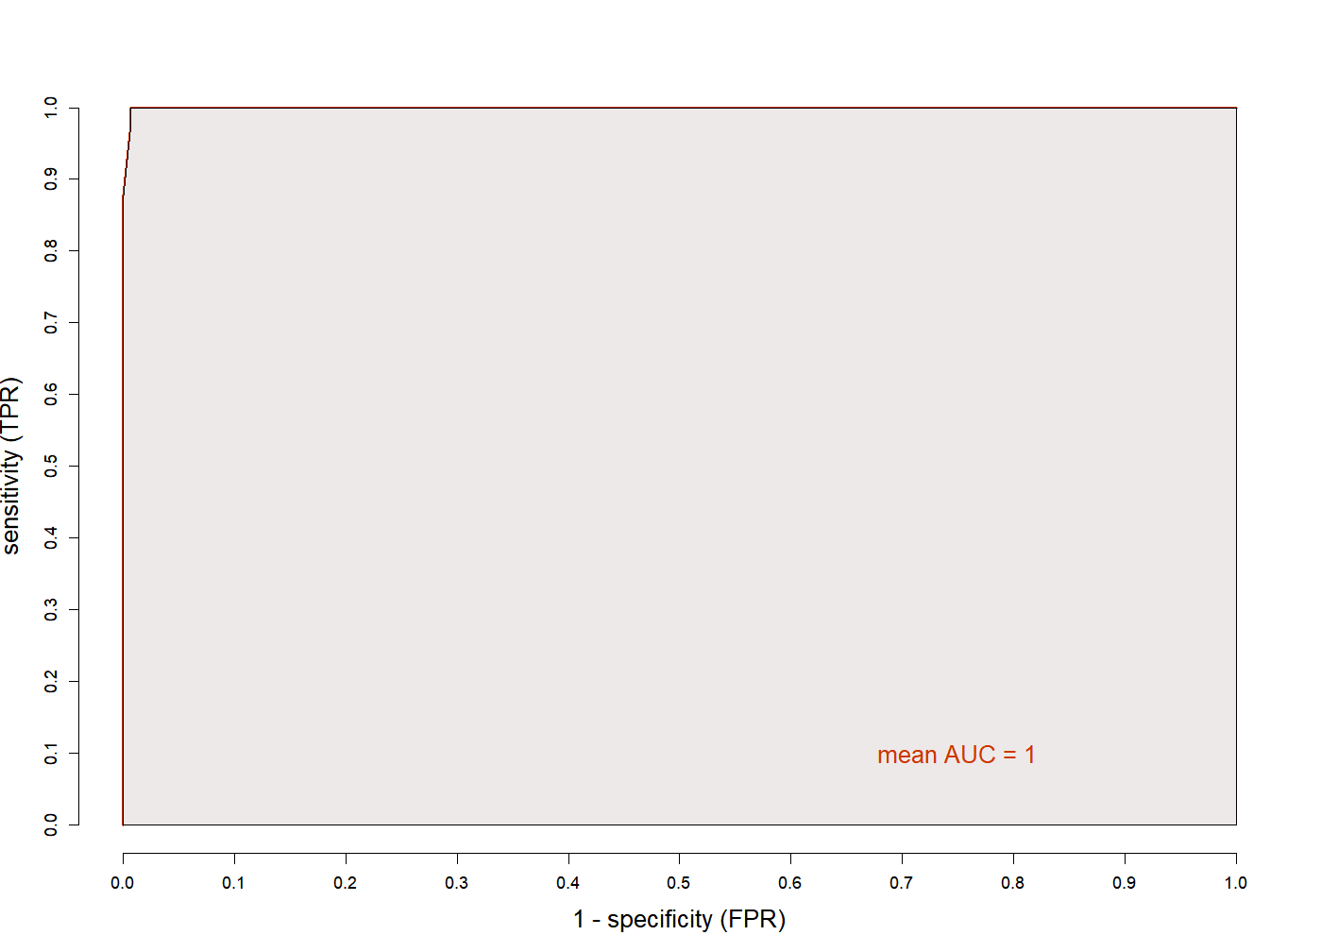
ROC
Genetic Reducer

Slide 23
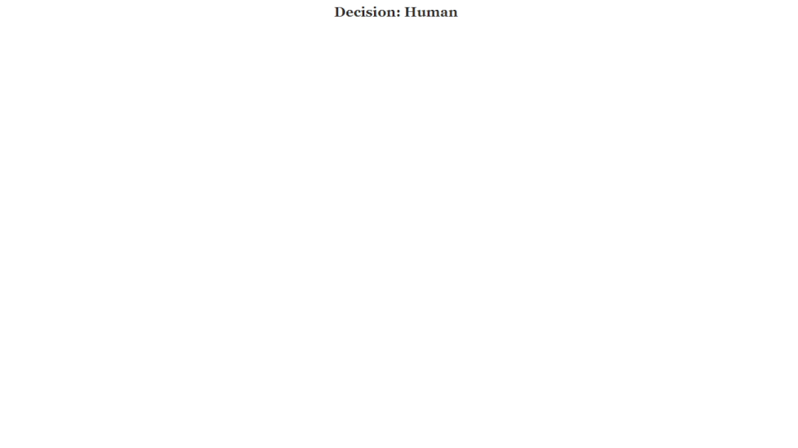
Issue computing large graph in VisuNet

